Slide 1
Introduction to web frameworks

Slide 2
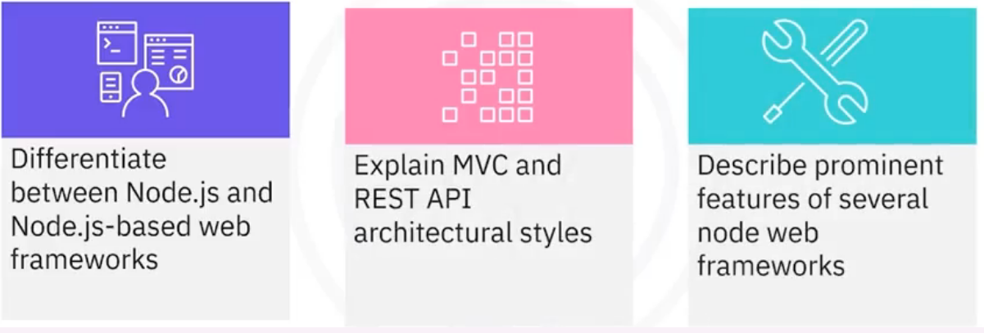
What you will learn

Slide 3
Runtime Environments
• Node.js IS NOT a web framework
• Node.js IS a runtime environment that executes JavaScript on
a server
• Runtime environments are the hardware and software that can
execute programs with a particular codebase

Slide 4

Node framework
• Web frameworks are the skeletons on which an application is built
• Fundamental structure that supports the application
• Node.js requires a web framework to utilize it
• Node.js frameworks are called node frameworks
• Two approaches to building back ends:
• Model-View-Controller (MVC)
• Representational state transfer application
programming interface (REST API)
• Applications can use both MVC and REST APIs
• They are not mutually exclusive

Slide 5
Model-View-Controller (MVC)
model
Interacts with
database and
handles data
logic
Manages data
Regulates
data flow
Controller
View
Processes
data provided
by user
Renders
presentation
of the data

Slide 6
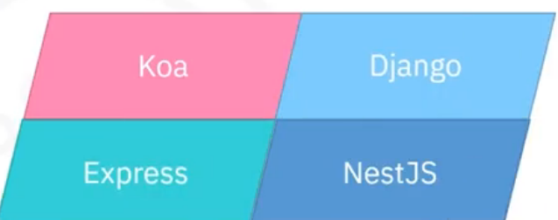
Popular frameworks that can implement MVC
• Used for apps that need separation of
the data, from the data presentation,
and from the manipulation of data

Slide 7
REST APIs
• Allow multiple web services to communicate with each other
and the client
• RESTful APIs:
• Client and server code are independent of each other
• Client does not know the state of the server and vice versa (stateless)
• Communicate via operations on resources
• Communication does not rely on an implementation of the API

Slide 8


Data transfer with a RESTful API
Web Service Server
Rest API:
GET (resource)
Client
Rest API: returns (JSON
payload, status code)

Slide 9
Express
• One of the most popular node frameworks
• Primarily used for routing and middleware
• Small learning curve because it uses JavaScript
• Easy to implement an MVC architecture pattern
• Provides debugging mechanisms

Slide 10
Express advantages
• Handles multiple operation requests concurrently
• Has HTTP helpers for handling HTTP requests
• Helps facilitate communication between client and
server
• Efficiently provides HTTP headers to URLS to get
needed data requested by the client

Slide 11
Koa
• Designed by the same team that designed Express
• More robust foundation for web applications and APIs
• Uses Async functions such that callbacks are not necessary
• Increased error-handling ability
• Appropriate for applications that are
• High-performance
• Demanding
• Complex
• Developed by large experienced teams

Slide 12
Socket.io
• Best for apps with real-time bidirectional data exchange
between clients and servers
• Utilizes WebSocket rather than HTTP for communication
• Servers push data without a request from the client
• Works well for applications such as
• Chat rooms
. Texting
• Video conferencing
• Multiplayer games

Slide 13
Hapi.js
• Open source
• Lots of built-in security
• Many built-in plugins so no need for unofficial middleware
• Good for developing:
• Proxy servers
• API servers
• HTTP proxy applications
• REST APIs

Slide 14
NestJS
• Appropriate for dynamic, scalable, enterprise applications
• Flexible
• Multitude of libraries
• Easy to implement an MVC architecture
• Built on top of Express
• Compatible with TypeScript
• Works in conjunction with the Angular framework
• Combines object-oriented and functional reactive
programming

Slide 15
Recap
In this video, you learned that:
• Node.js is a runtime environment, whereas node web
frameworks use the Node.js environment to run
• The MVC architecture style divides a back-end application into
three parts: the model, the view, and the controller
• REST API frameworks use HTTP methods to communicate with
each other
• Several popular node frameworks include Express, Koa,
Hapi.js, and NestJS

